Slide 1
INTERVIEW SKILLS ACTIVITY
Group Members:
Muhammad Hassan
Zeemal Nadeem
Usmar Haider
Farheen Latif
Mahnoor

Slide 2
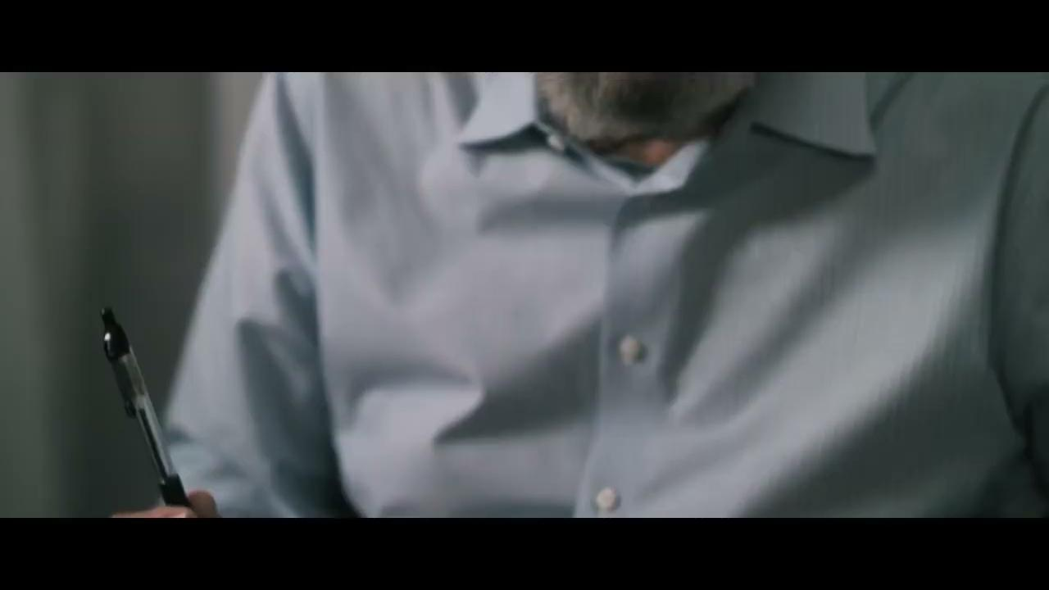

Slide 3
Mistakes
Use of Mobile Phone
No clear knowledge of field
False information mentioned in CV
Unprofessional Behavior
High Tone
Lose Temper

Slide 4
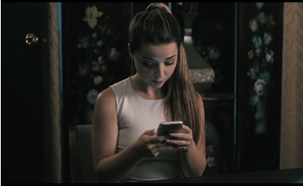
a
Use of mobile phone:
She was continuously using mobile phone at the start of the interview and not showing interest to the questions of the interviewer
Mistake 1

Slide 5
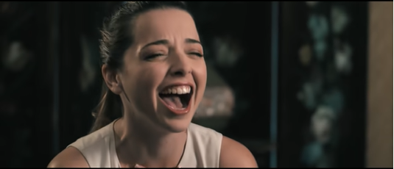
Unprofessional Behaviour:
Laughing
Giving irrelevant answers
Use of SIRI
Friendly behaviour
Mistake 2

Slide 6
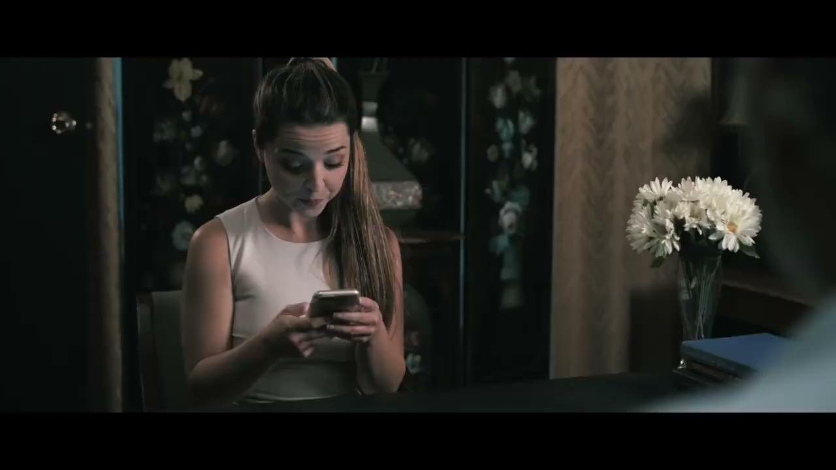
False Information Mentioned in CV:
She has mentioned that she is a technology trainer but she don’t even know the basics of technical aaps.
Mistakake 3

Slide 7
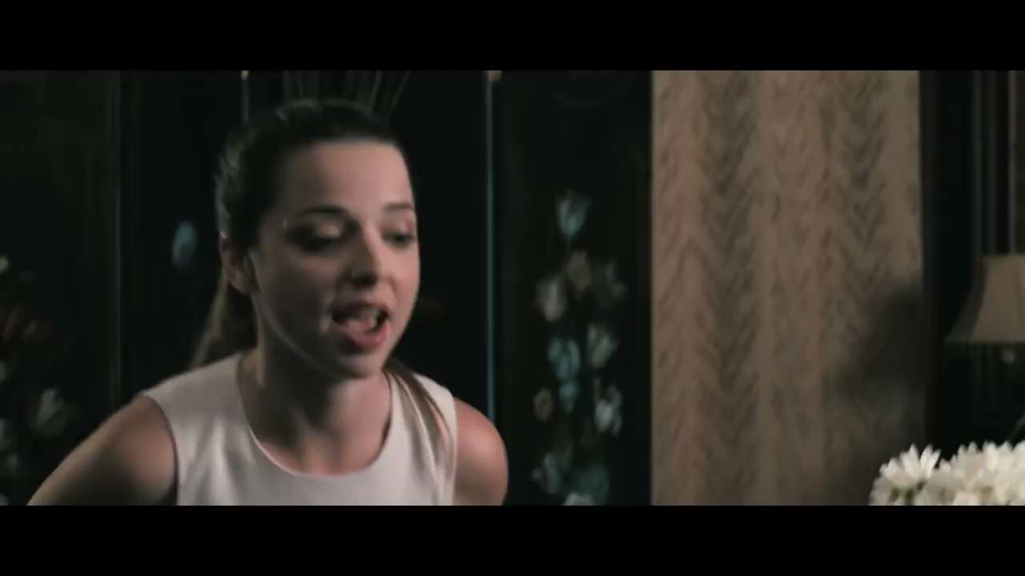
Lose Temper:
At the end after watching her non serious attitude when the interviewer said you are not a good fit she started misbehaving with him.
Mistake 4

Slide 8


